Slide 1
Quantitative Analysis

Slide 2
Quantitative analysis using spectrometry
involves determining the concentration of a substance in a sample by measuring the intensity of a specific signal or response from the spectrometer.
UV-Visible Spectrophotometry
Principle: Measures the absorption of light in the ultraviolet (UV) or visible region by a sample.
Quantitative Analysis: Beer-Lambert Law relates the absorbance of light to the concentration of the absorbing substance.

Slide 3
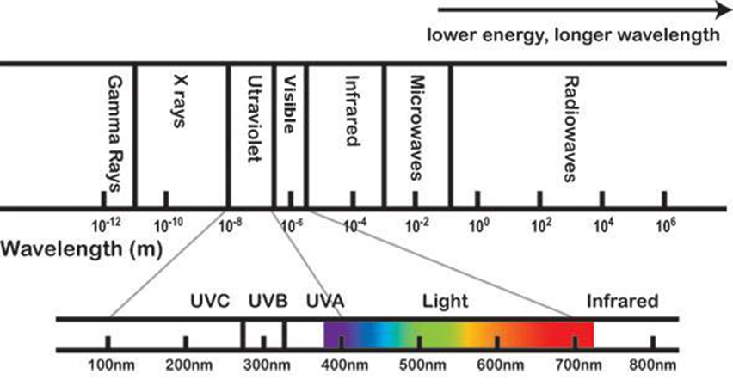
Electromagnetic Spectrum
The electromagnetic (EM) spectrum is the range of all types of EM radiation.
Radio waves, microwaves, infrared, visible light, ultraviolet, X-rays, and gamma rays

Slide 4
ultraviolet (UV) , visible region
The UV region typically covers the wavelength range of 100 to 400 nanometers (nm). UV light is more energetic than visible light, and electronic transitions in the UV region are associated with changes in the electronic energy levels of the molecules.
The visible region spans the wavelength range of 400 to 700 nm. The colors we perceive are a result of the absorption and reflection of certain wavelengths of visible light by substances

Slide 5
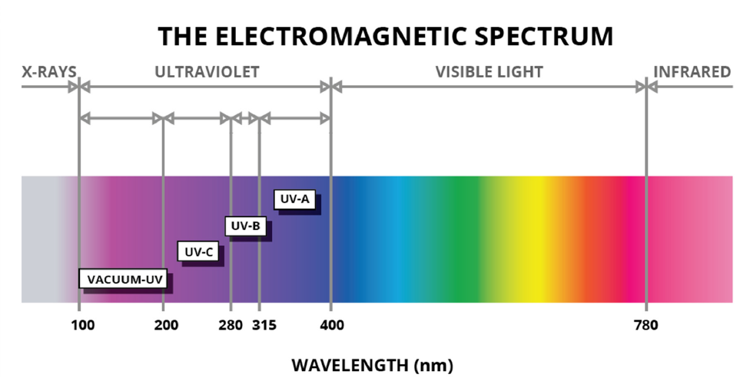
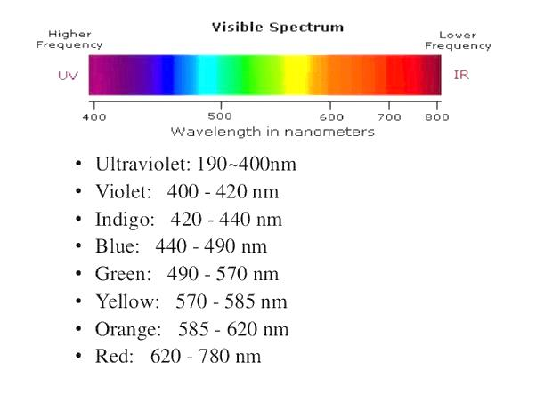

Slide 6
Quantitative Analysis
The Beer-Lambert Law is fundamental to quantitative analysis in UV-Visible spectrophotometry.
It states that the absorbance (A) of a sample is directly proportional to its concentration (c) and the path length (l) of the sample cell:
A = εcl
where ε is the molar absorptivity (or molar extinction coefficient) at a specific wavelength.

Slide 7
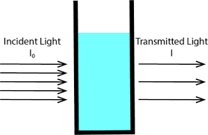

Slide 8
Calibration Curve
To perform quantitative analysis, a calibration curve is often prepared. This involves measuring the absorbance of standard solutions with known concentrations at a specific wavelength. The relationship between absorbance and concentration is then used to determine the concentration of an unknown sample.

Slide 9
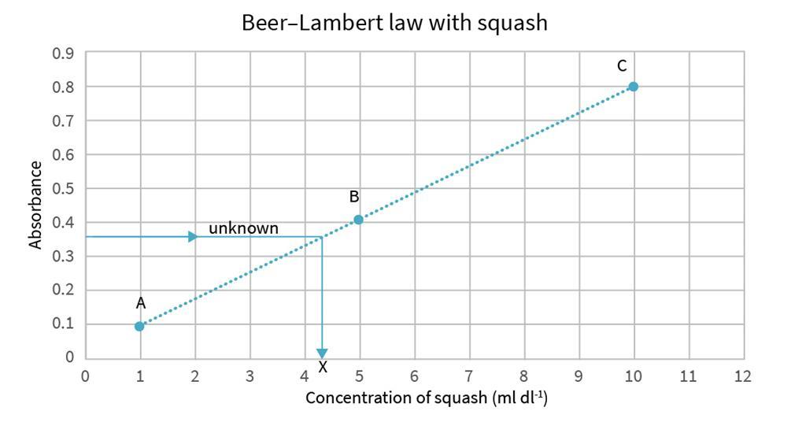

Slide 10
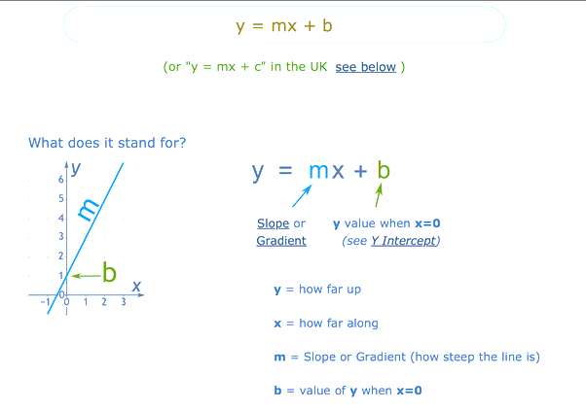
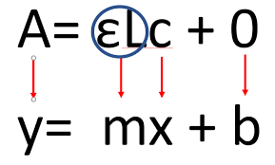
Determine the Molar Absorptivity
The slope (m) of the line corresponds to ε⋅l, so you can determine the molar absorptivity (ε) by dividing the slope by the path length (l).
y=mx+b

Slide 11
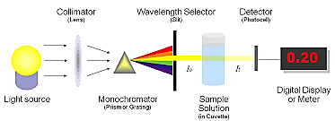
UV-Visible spectrophotometry
UV-Visible spectrophotometry is a common analytical technique that involves measuring the absorption of ultraviolet (UV) or visible light by a sample. This method is widely used for quantitative analysis in various fields, including chemistry, biochemistry, and environmental science.

Slide 12
Absorbance (A):
Definition: Absorbance, often denoted as "A," is a unitless measure of the amount of light absorbed by a sample. It is calculated using the formula:
A=−log10​(T) where T is the transmittance (the fraction of incident light transmitted through the sample).
Transmittance (%T):
Definition: Transmittance, denoted as "%T," represents the percentage of incident light that passes through a sample. It is calculated using the formula:

Slide 13
Determine the concentration of an unknown sample
Prepare Standard Solutions:
Create a series of standard solutions with known concentrations of the substance of interest. These concentrations should cover the expected range of concentrations in your samples.
2. Measure Absorbance:
Measure the absorbance of each standard solution at a specific wavelength using a spectrophotometer. The chosen wavelength should correspond to the absorption maximum of the substance.

Slide 14
3.Plot the Calibration Curve:
Plot a graph with absorbance on the y-axis and concentration on the x-axis. Each point on the graph represents the absorbance of a standard solution at a specific concentration.
4.Determine the Molar Absorptivity
5.Quantitative Analysis:
Use the calibration curve to determine the concentration of an unknown sample by measuring its absorbance and applying the equation derived from the linear regression.

Slide 15
1- Prepare a stock solution for the stander
2-Reduce the concentration of the stock solution to four solutions
3- measure the absorbance of each of the four solutions
4- extract the slope value from graph
5- measure the absorbance value of the solution of unknown concentration
6- calculate the concentration from Beer-Lambert’s law

